Slide 1
Netflix Data Analysis with Python
TEAMMATES:
2010030468 SATWIK
2010030490 VARUNKRISHNA
2010030494 SHASHIKANTH
2010030463 ANIL KUMAR

Slide 2
TABLE OF CONTENTS
Abstract
Introduction
Literature review
Methods
Results
Discussion
Conclusion

Slide 3

ABSTRACT
Some very important models of Netflix data to understand what’s best for their business. Some of the most important tasks that we can analyze from Netflix data are:
understand what content is available
understand the similarities between the content
understand the network between actors and directors
what exactly Netflix is focusing on
and sentiment analysis of content available on Netflix.
The project is made using different utility analytical tools present in Python Library of versatile packages

Slide 4
INTRODUCTION
Data visualization is basically a graphical representation of data and information. It is mainly used for data cleaning, exploratory data analysis, and proper effective communication with business stakeholders.
Right now the demand for data scientists is on the rise. Day by day we are shifting towards a data-driven world.
It is highly beneficial to be able to make decisions from data and use the skill of visualization to tell stories about what, when, where, and how data might lead us to a fruitful outcome.
Data visualization helps us in curating data into a form that is easily understandable and also helps in highlighting a specific portion.

Slide 5
LITERATURE REVIEW
1.) Exploratory and Sentiment Analysis of Netflix Data:
AUTHORS: Vadloori , Karthik Babu, and Shriya Madhavi Sanghishetty.
developing unique interactive solutions and methods that are confined to make data exploration much more intriguing in nature. These constant advancements have stabilized a promising direction for data analysis as a systemic study that is going to stay as long as there is the crunch for data in any viable field of study in the real-world.
2.)Offering Recommendations on Netflix dataset by Associations among Users as Trust Metric :
AUTHORS :Rajeswari Nakka, Dr, G. V. S. N. R. V. Prasad, and R. Kiran Kumar.
This paper focuses on applying machine learning techniques to offer recommendations on Netflix dataset by implementing associations among users as a trust metric. As the machine learning process requires huge computations and consumes more time for processing large datasets, the services of cloud is used for computations and to perform the analysis.
."

Slide 6
DATA MANAGEMENT IN AUDIOVISUAL BUSINESS: NETFLIX AS A CASE STUDY:
In the analyzed case we see how extraction and data management, and subsequent analysis and decision-making, has become a competitive business advantage. A business gearing its supply in relation to the demands and preferences of the user.

Slide 7
METHODS & techniques
METHODS TO VISUALIZE DATA:
Correlation heat map
Funnel plot representation
Dashboards
Word Cloud
TECHNIQUES :
Netflix itself automatically collects other forms of data, such as the platform used to watch Netflix, a user’s :
watch history
search queries,
time spent watching a show
Collects some bits of data from other sources, such as
demographic data,
interest-based data,
and Internet browsing behavior.

Slide 8
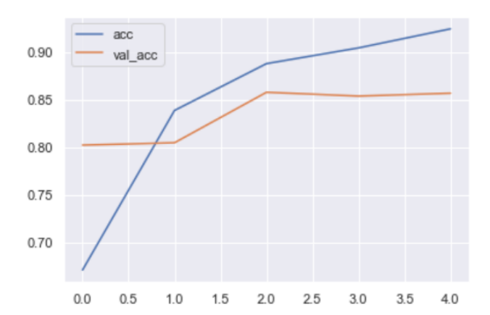
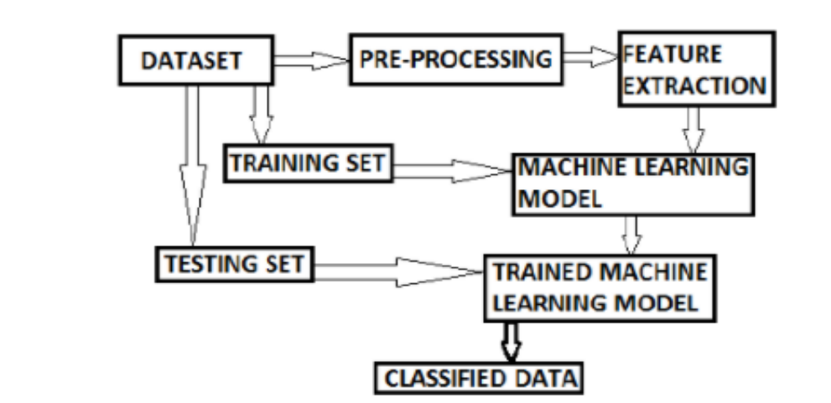
Accuracy plot of the model
Sentiment Analysis Methodology

Slide 9
RESULTS
We have successfully cleaned the redundant records by removing them, and filtered the Data Set by discarding unused features.
Built a plotting for size of Series & Movies in the dataset and also plotted IMDB_SCORES based on their relevance count.
Created a WORDCLOUD – both unmasked and masked – based on the relevance of the Genres in the dataset.
Insights based on Superhit, Hit, Average and Flop box-office status of a Title using IMDb and Hidden Gem Score as interlinked criteria, decided based on their correlation.
Plotted the country wise count of Netflix Titles using Funnel Plot and developed a Geospatial Plot using Folium based on the latter feature. •

Slide 10
Built a Sentiment Analysis Model by fitting the Series/Movie Reviews dataset, which obtains the result by making use of the summary column in the Netflix dataset.
Displayed the accuracy and loss of the above model fitting as a plot.

Slide 11
DISSCUSSION
Netflix is one of the early adapters in bigdata analytics.
• Use of bigdata analytics has resulted in customer satisfaction.
• Data analytics has helped Netflix in production of original content.
• Data analytics has helped Netflix to be leader of streaming market.
Recent technological advancement and impact on product offerings.
Improving quality of streaming with less data consumption to support 4K content efficiently.
A new software called 'Hermes' is developed by Netflix Research which automatically grades a translation. With the use of this Netflix will be able to serve the faster and good quality translation of shows to different countries.

Slide 12
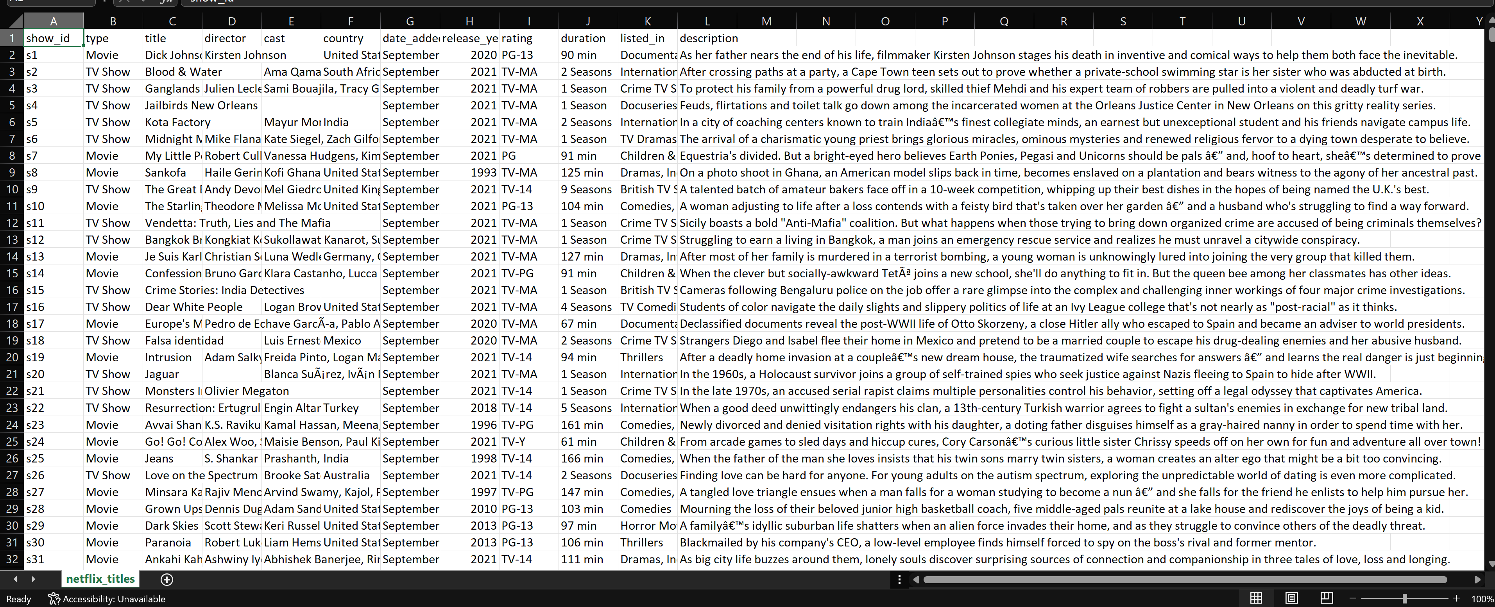
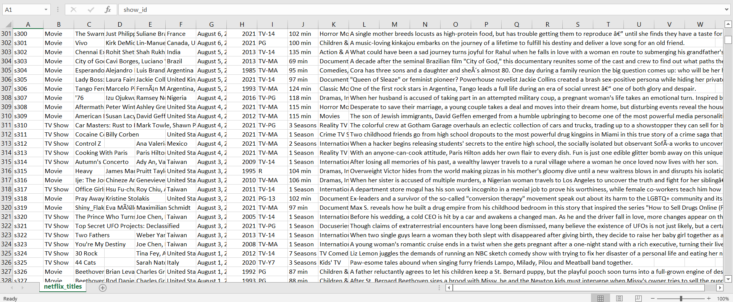
DATASET COLLECTION

Slide 13
TOOL SETUP
First, make sure you have Python installed on your machine.
Also, you need to install three Python packages. You can do that by running the following pip (package installer for Python) commands in your terminal
pip install pandas pip install plotly pip install dash

Slide 14
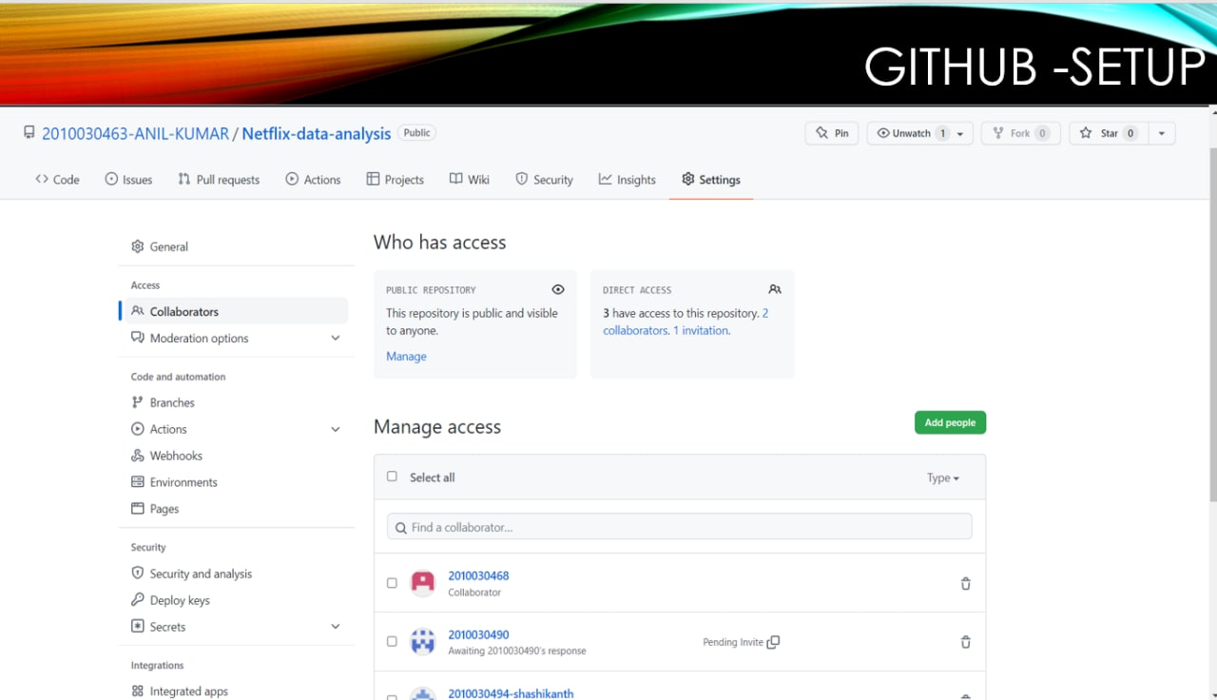

Slide 15
conclusion
Data Analysis is a fundamental step to address the various needs of a client in any professional spectrum. The varied range of insights that can be derived from a data is itself
These insights maintain a clear sight and perspective for various stakeholders and help in targeting a positive vision for the future.
FUTURE SCOPE:
The future scope of Data Analysis is bound to remain intact as long as businesses require Data Science in their everyday applicable decision-making processes.

Slide 16
REFERRED LINKS
https://www.analyticsvidhya.com/blog/2021/07/visualizing-netflix-data-using-python/#h2_8
https://thecleverprogrammer.com/2021/01/16/netflix-data-analysis-with-python/
https://www.kaggle.com/chirag9073/netflix-data-analysis
https://towardsdatascience.com/visualizing-netflix-data-with-python-bca60a2632d9
https://www.researchgate.net/publication/354719521_Exploratory_and_Sentiment_Analysis_of_Netflix_Data
https://towardsdatascience.com/data-analysis-on-ott-platforms-which-service-should-i-choose-8eed953ff7d2

